Slide 1
Analytic Storytelling
By Vishal Puppala, Marvin Lee, Baha Amour, Akaron Davis, Bethel Kameni

Slide 2
Our Mission
Uncovering hidden relationships between the level of education and core financial data (Median Household income) and key socioeconomic factors that vary by state and by year
We performed a targeted analysis which bucketed our data by: % of college graduates.
5 Most Educated States: DC, Colorado, Massachusetts, Maryland, Connecticut
5 Least Educated States: Louisiana, West Virginia, Arkansas, Kentucky, Mississippi
Methodology:
Graphically and empirically sought to find if there was an underlying statistical relationship between different socioeconomic factors that persisted when varying years, clusters, and states

Slide 3
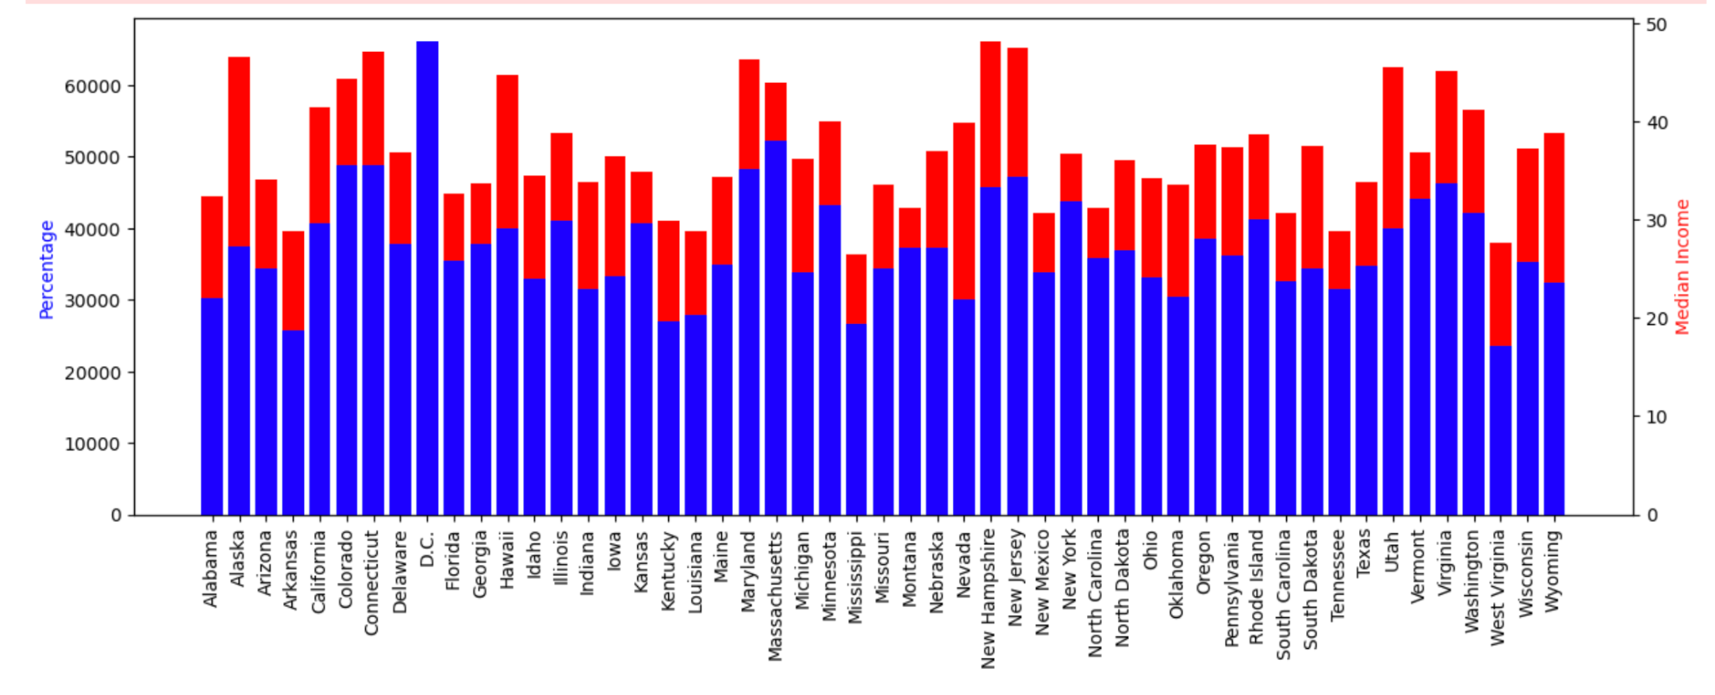
Executive Summary
States with higher levels of education have higher levels of income

Slide 4
Credit Card Debt per Capita vs. Median Household Income
SOURCE: The New York Federal Reserve Bank
Link: https://www.newyorkfed.org/microeconomics/databank.html
PURPOSE: Analyze the relationship between household income and credit card debt and see if there were any patterns

Slide 5
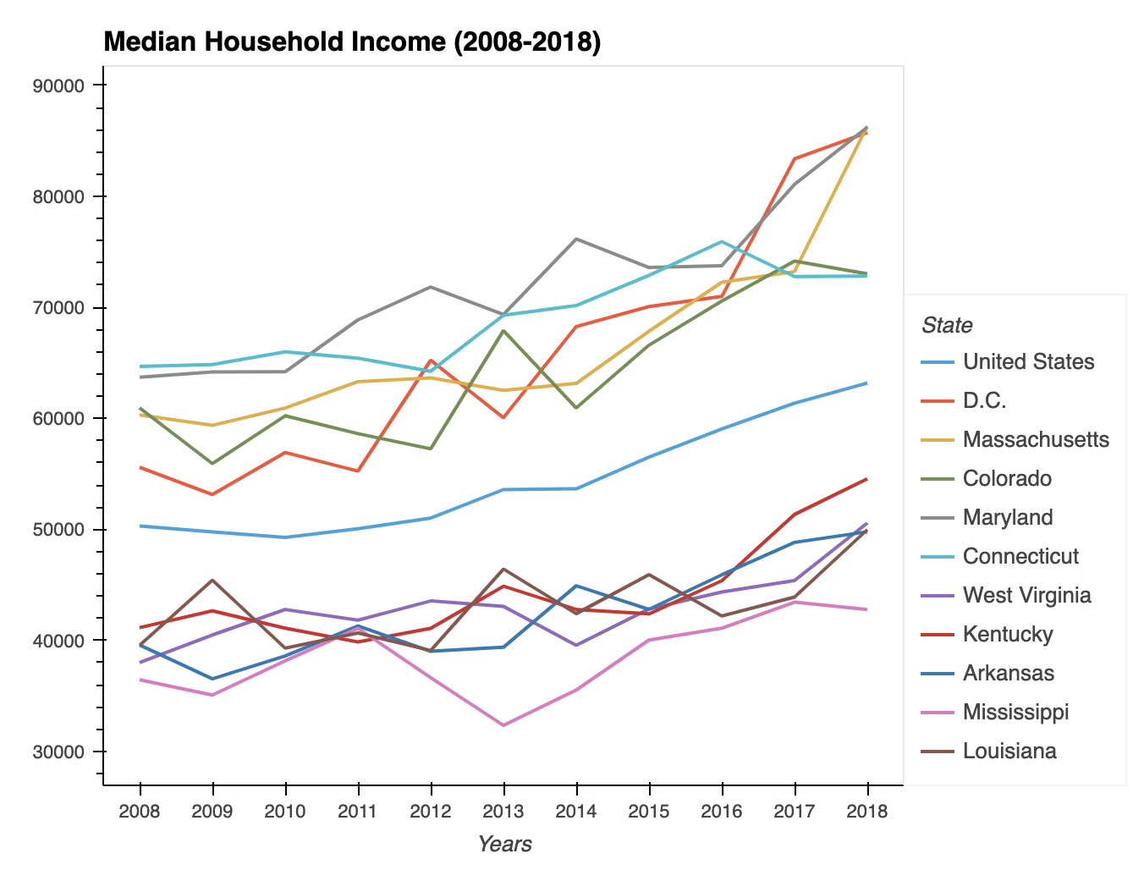
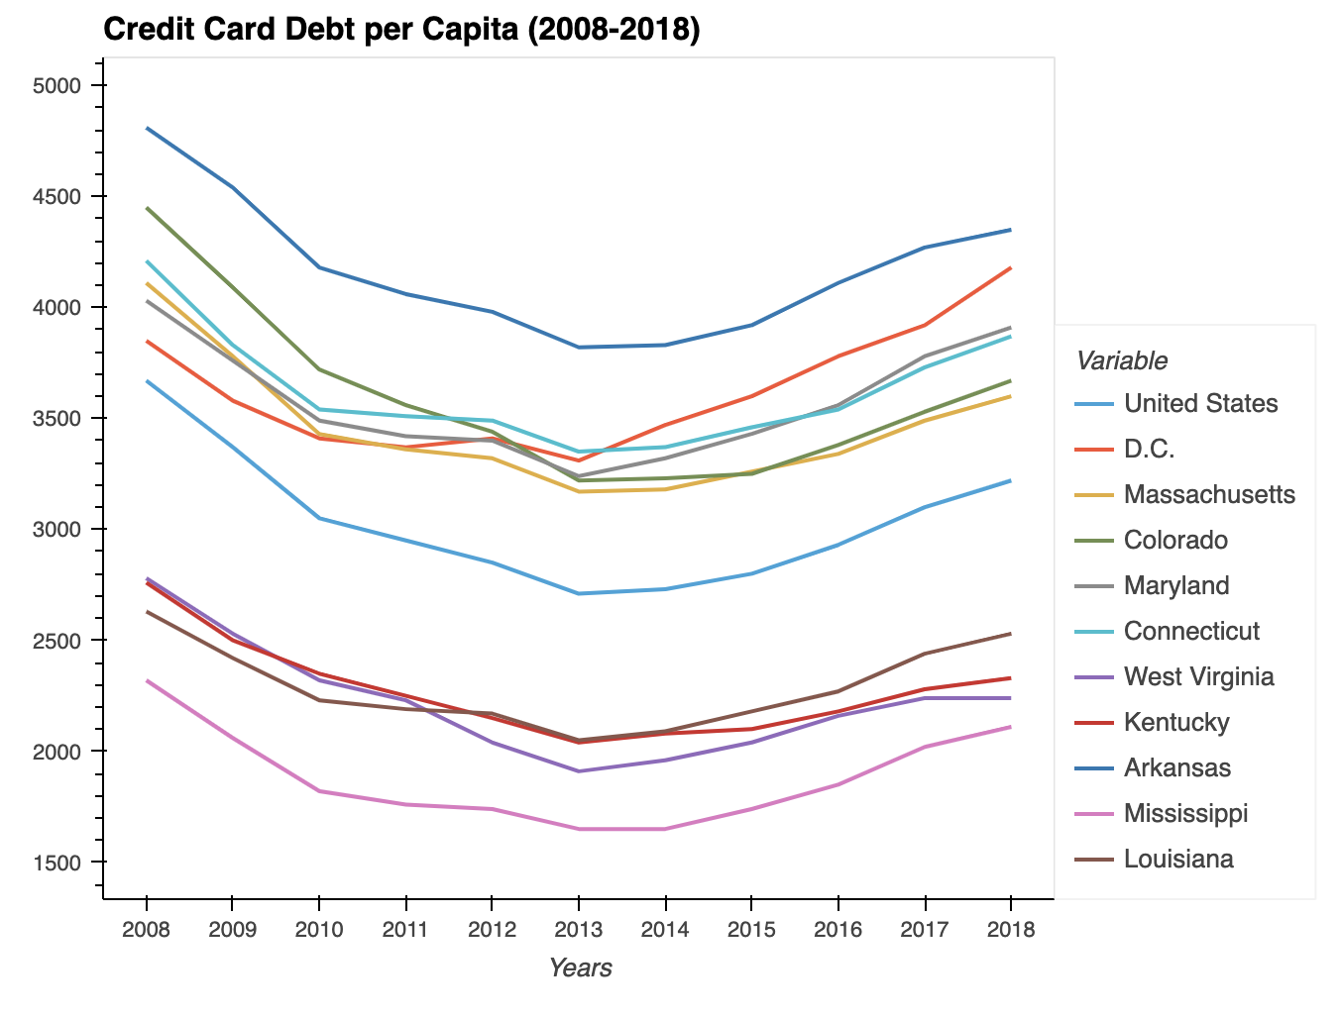
Median Household Income & Credit Card Debt per Capita
Mississippi has consistently been at the BOTTOM in terms of household income
Arkansas has consistently been at the TOP in terms of credit card debt per capita
Both states rank near the bottom in terms of education

Slide 6
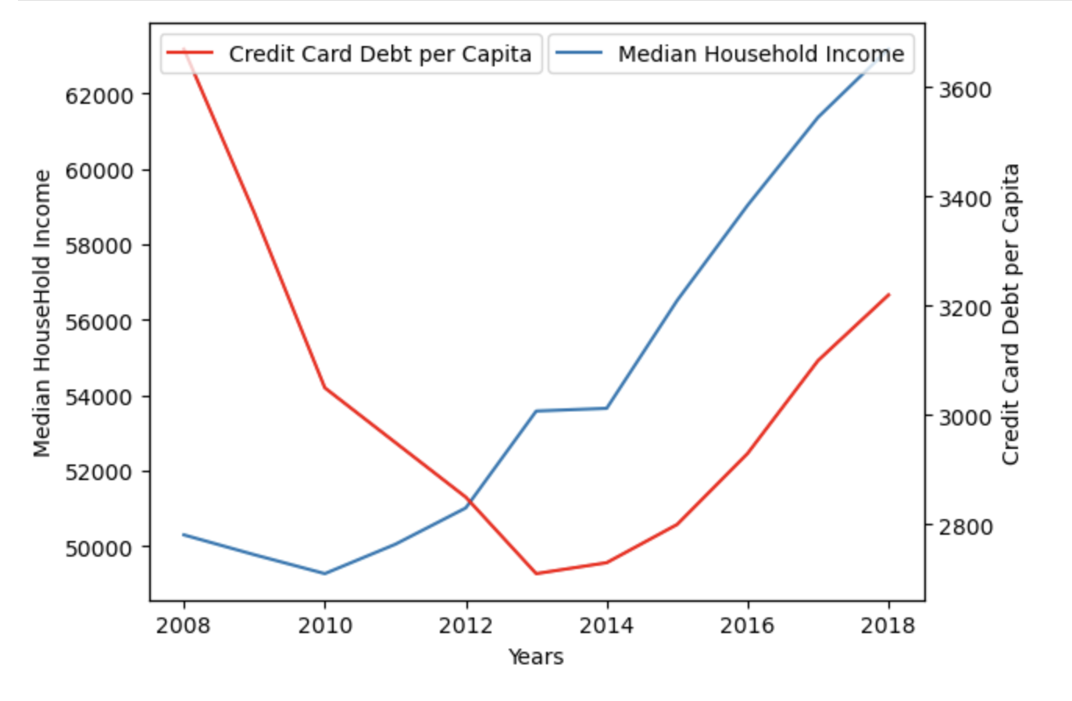
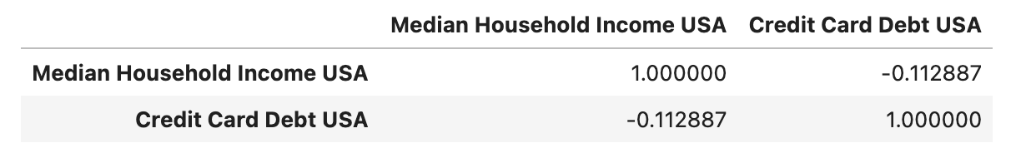
Across the U.S.A (2008-2018)

Slide 7
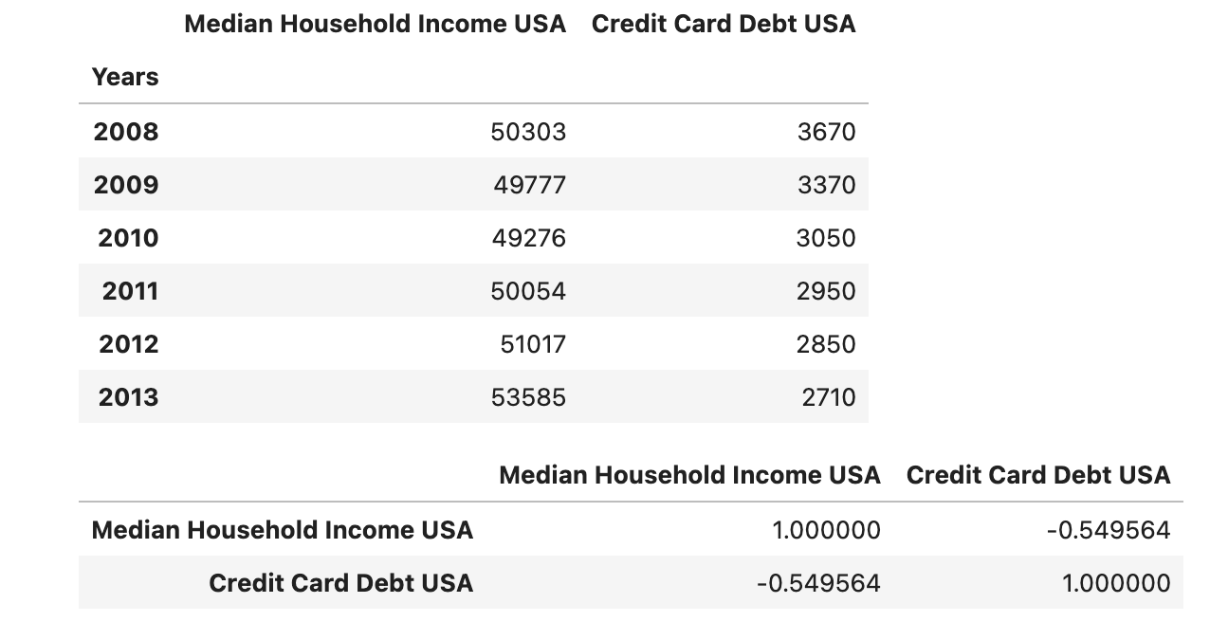
From 2008-2013 - USA

Slide 8
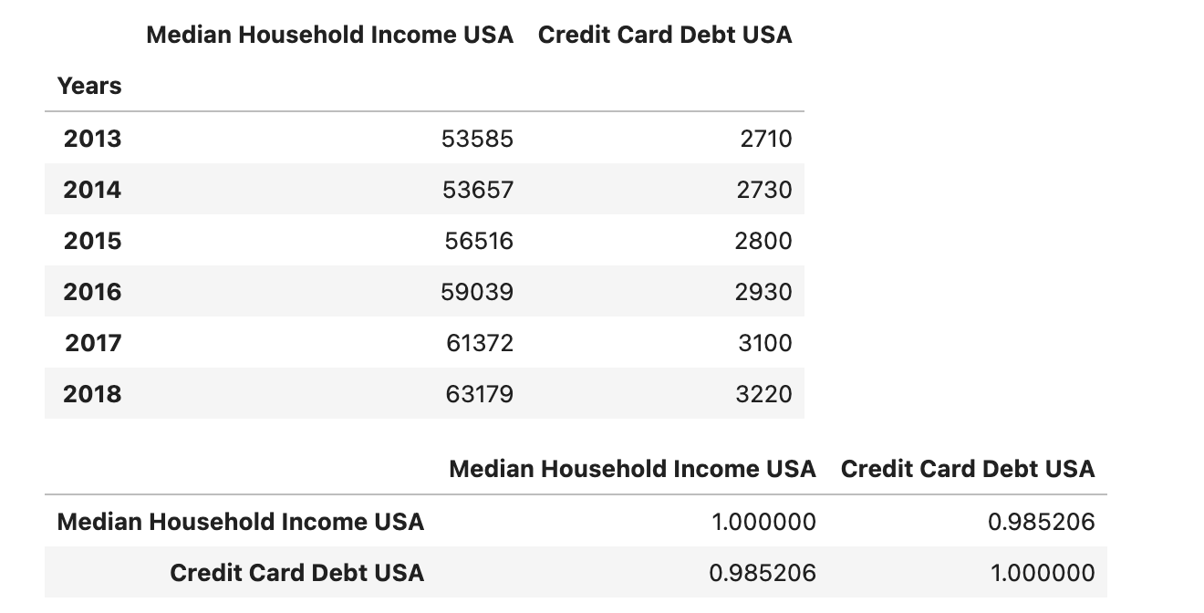
From 2013-2018

Slide 9
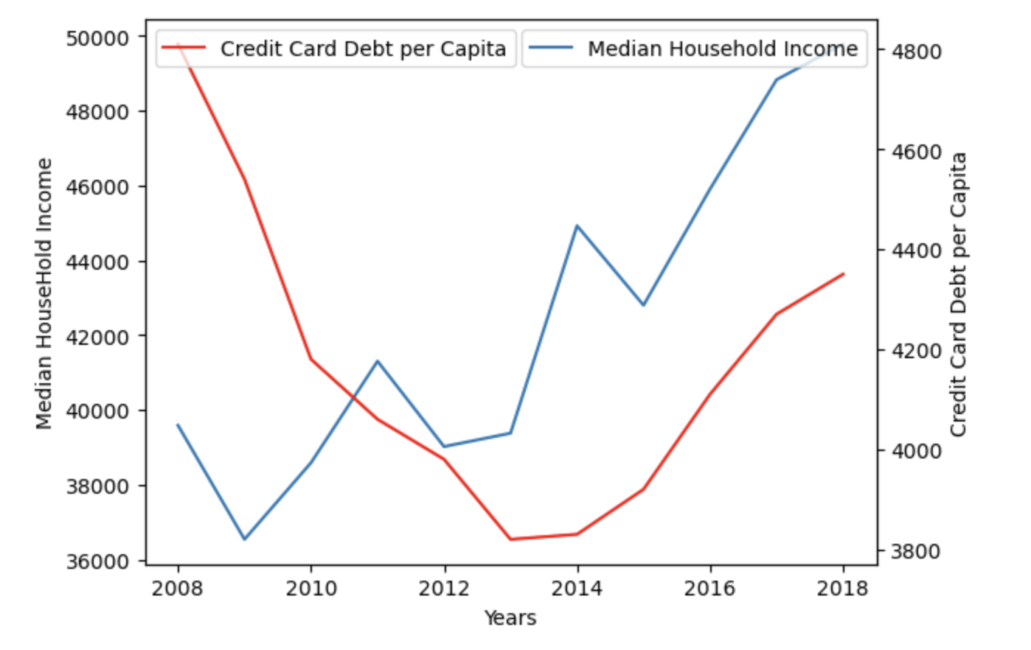
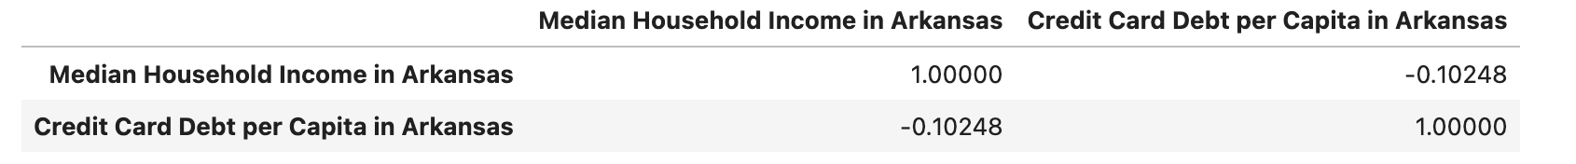
Arkansas (2008-2018)

Slide 10
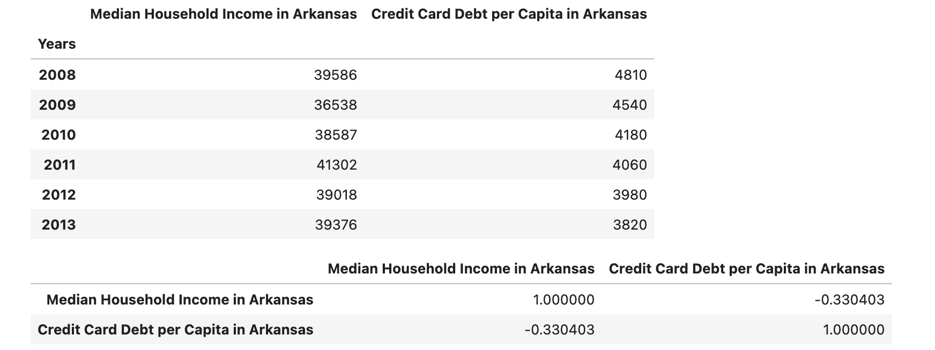
Arkansas (2008-2013)

Slide 11
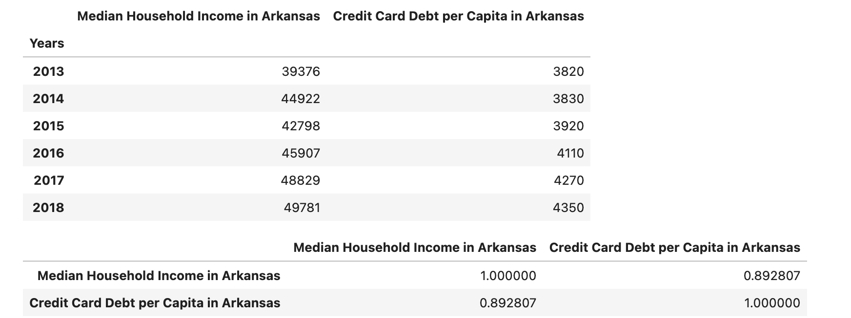
Arkansas (2013-2018)

Slide 12
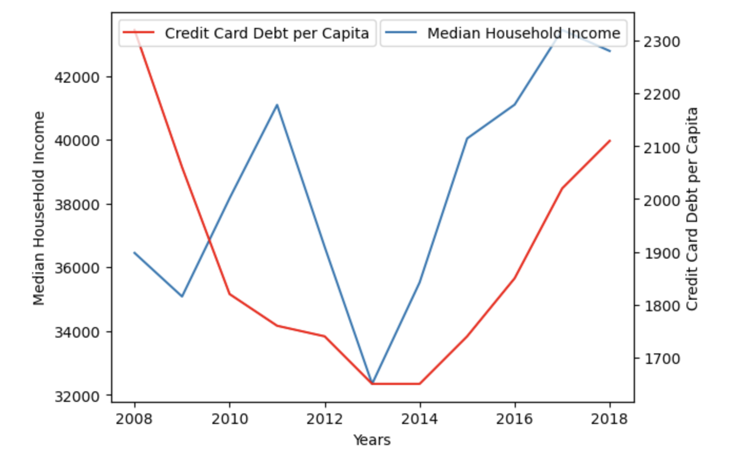
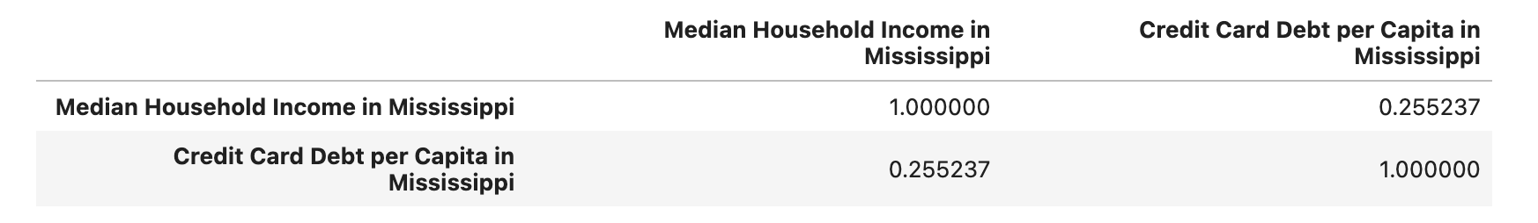
Mississippi (2008-2018)

Slide 13
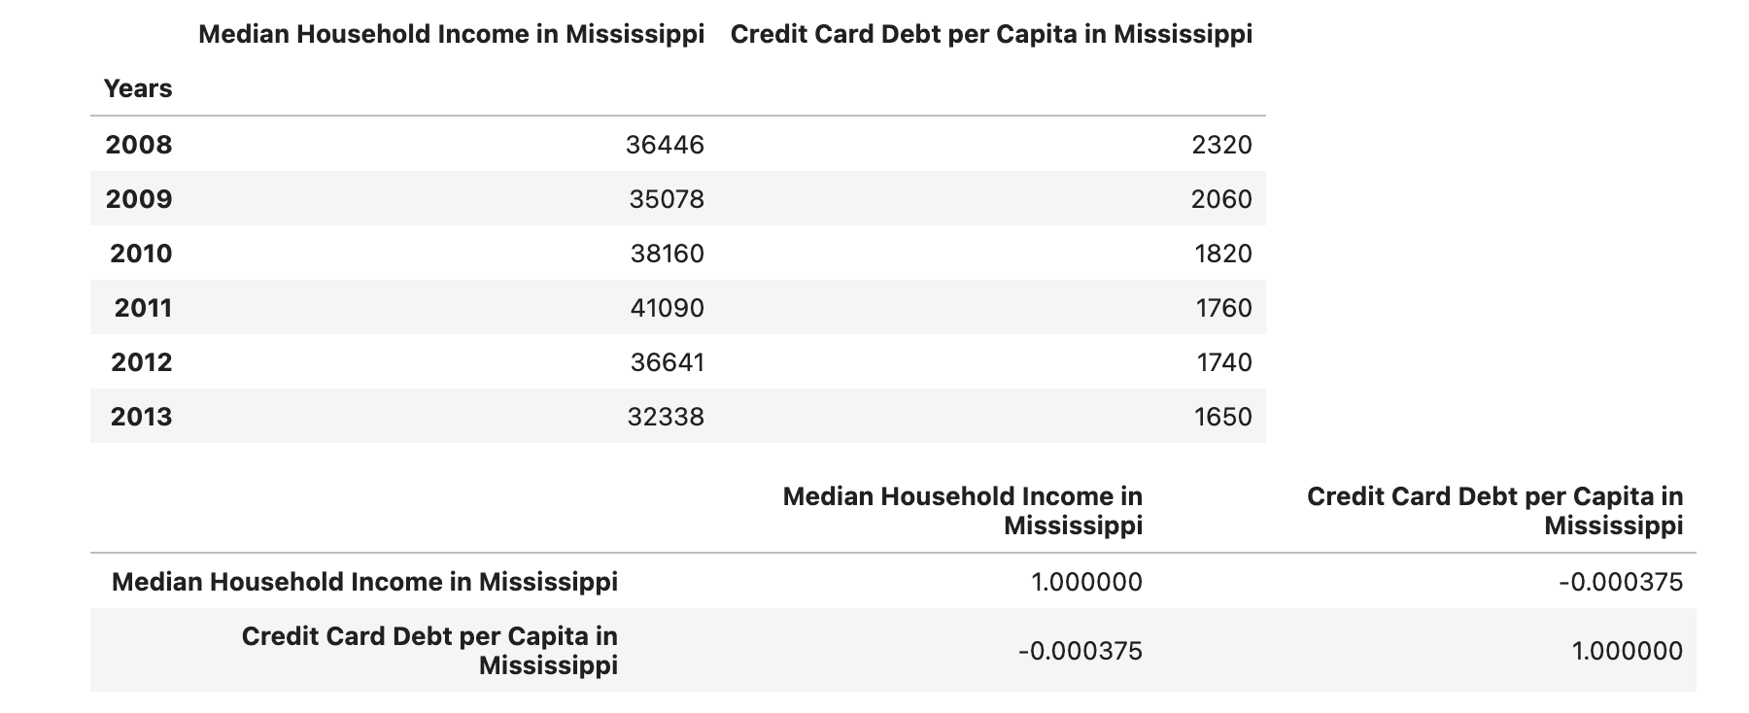
Mississippi (2008-2013)

Slide 14
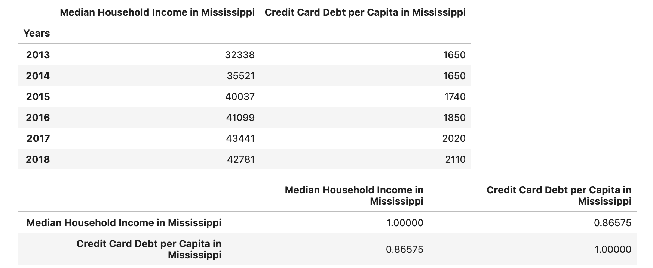
Mississippi (2013-2018)

Slide 15
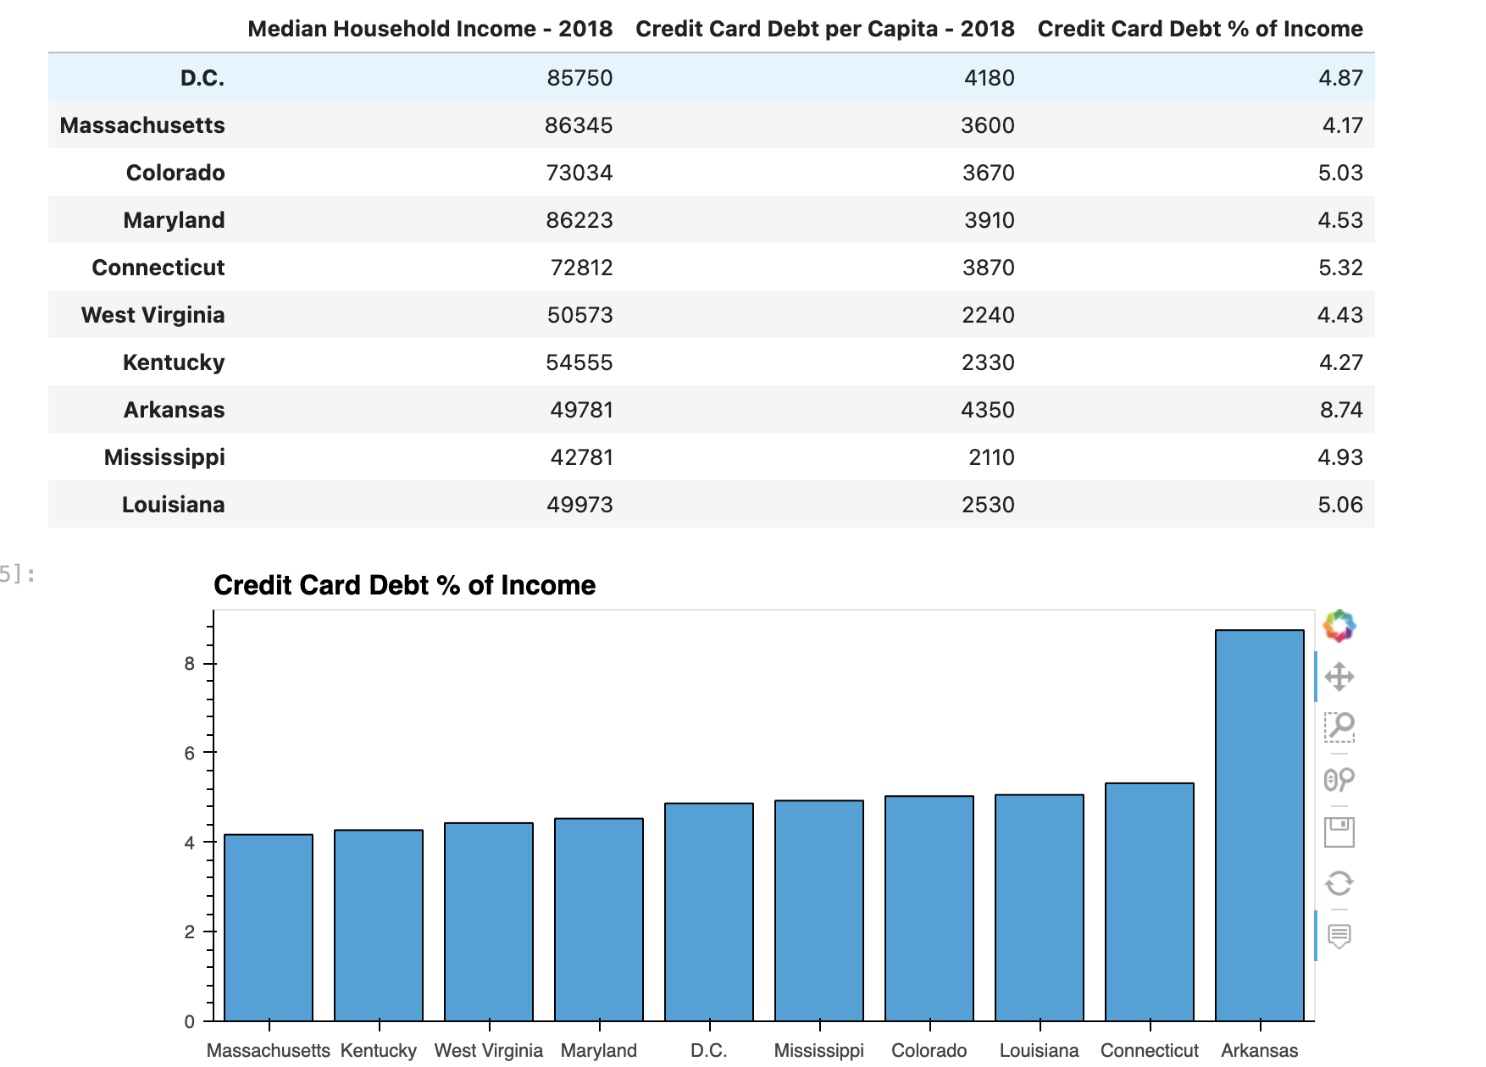
Credit Card Debt as a % of Household Income (2018)
In 2018, credit card debt per capita as a percentage of median household income is roughly 4-5% with Arkansas being the one outlier at 8.74%
Massachusetts ranks near the top in terms of education and Kentucky ranks near the bottom but they’re side by side next to each other.
The difference is negligible.

Slide 16
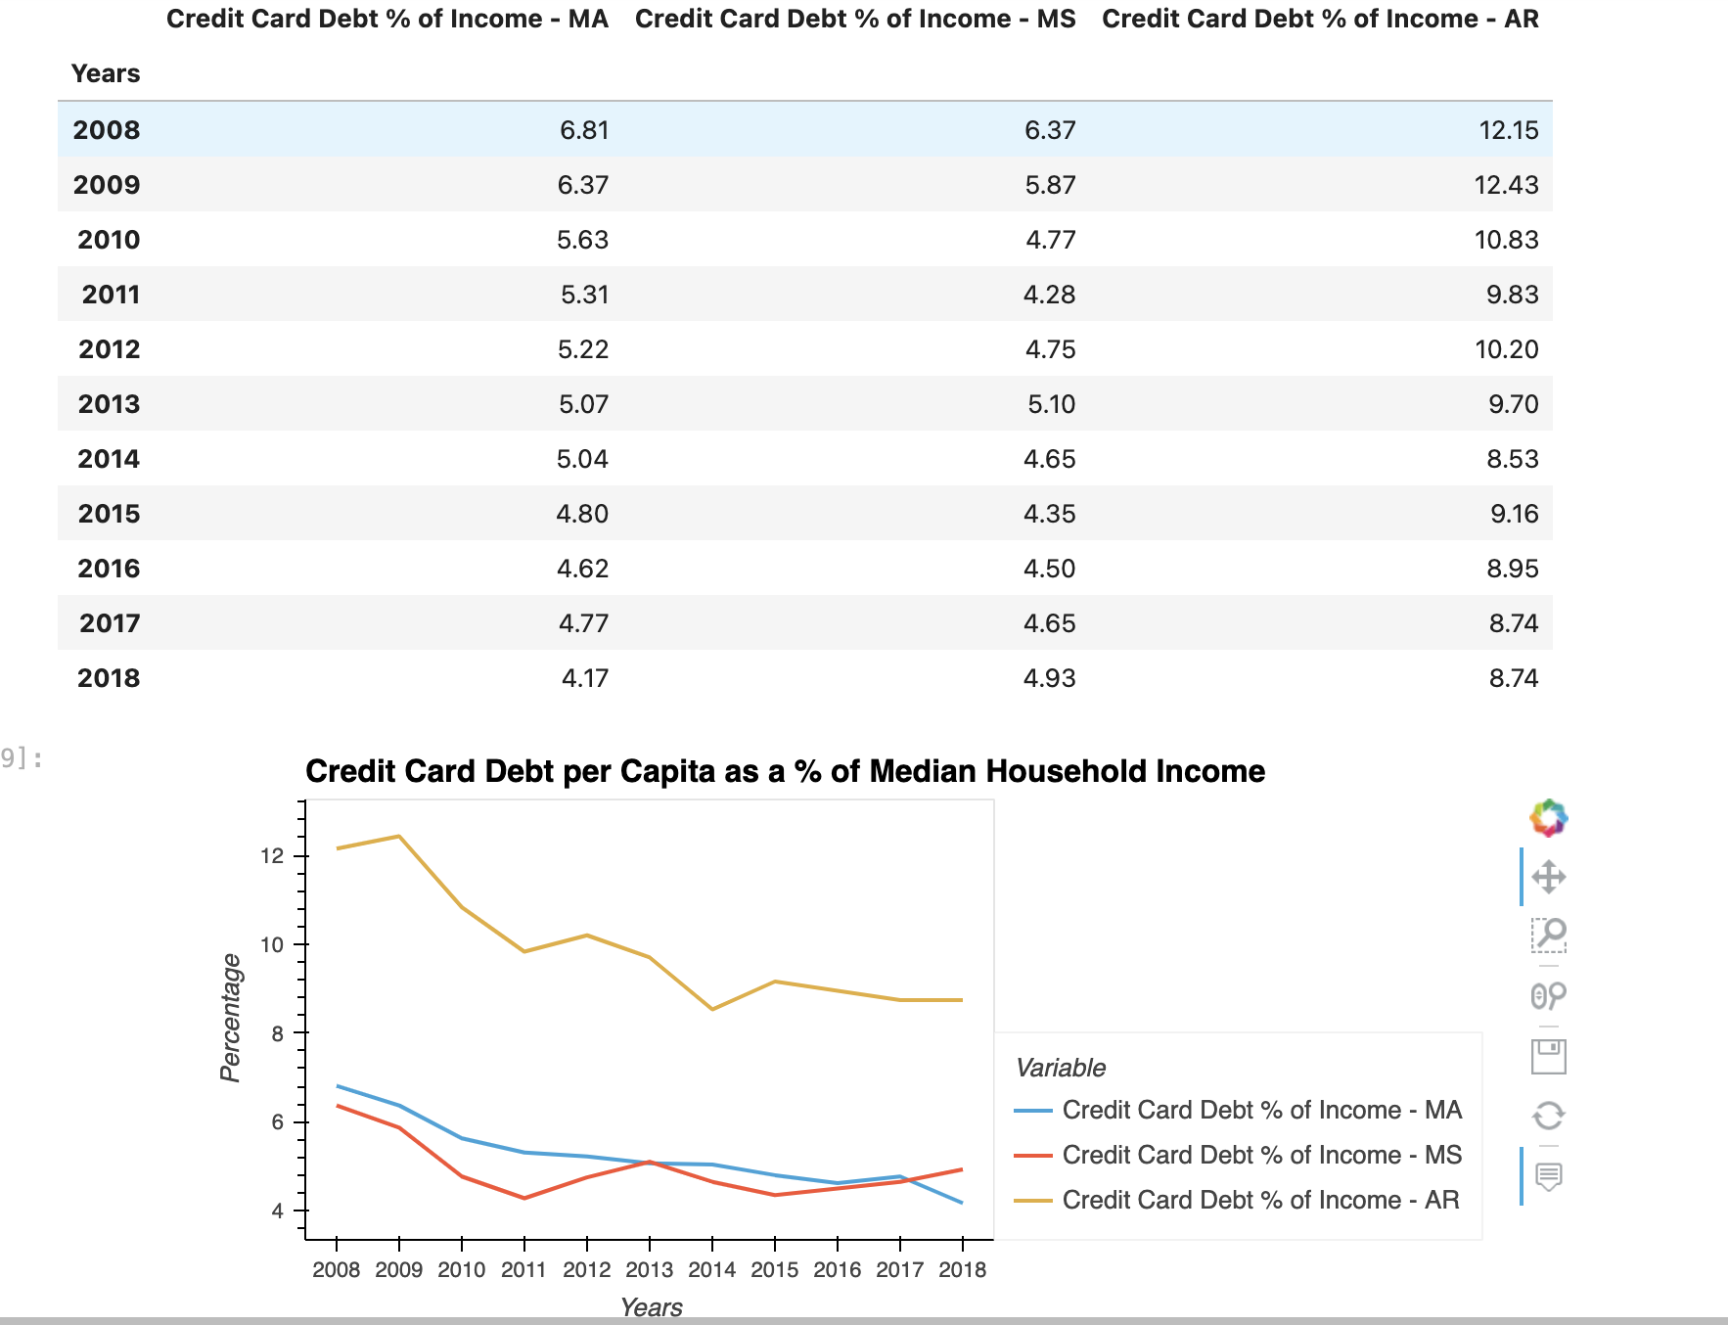
Has the percentage stayed the same over 10 years?
Looking at Massachusetts, Mississippi, and Arkansas, we see that from 2008-2018, credit card debt as a percentage of median household income has gone.
But zooming in from 2013-2018, the percentages have not really flucatated too much and have remained consistent.
While MA and MS have different levels of education, there’s not a distinguishable difference in terms of credit card debt % of income.

Slide 17
Credit Card Analysis Takeaway
Higher educated states do have higher levels of income and higher levels of credit card debt per capita
The correlations between household incomes and credit card debt is relatively weak over a longer period of time across all states despite education level
Wrong to say that higher incomes lead to a higher percentage of credit card debt relative to income
Correlation does not imply causation.
From 2013-2018, there was a strong positive correlation but that’s just 6 years.
Despite the difference in education levels, there’s no clear-cut relationship between how income affects the level of credit card debt

Slide 18
Unemployment

Slide 19
Next Steps
Scope Extension: more states, more socioeconomic factors, extend the timeline
Incorporate advanced techniques: machine learning, regression, principal component analysis
Bucket by political leaning instead of by education level?
Going beyond correlation
Could we also ask whether one variable predicts another, or asses causality?

